Slide 1
NATURAL LANGUAGE PROCESSING
Models and Algorithms
From rule-based systems to statistical models, neural networks, and transformers

Slide 2
The Evolution of NLP Models
Four eras of language modeling, each solving the limits of the one before
1
2
3
4
Rule-Based
Statistical
Neural Networks
Transformers
1950s–1980s
1990s–2000s
2010s
2017–present
Hand-crafted grammars and regex/pattern rules written by linguists.
Probabilities learned from corpora: n-grams, HMMs, Naive Bayes.
Learned word embeddings; RNNs, LSTMs, CNNs model context.
Self-attention enables large pretrained models: BERT, GPT, T5.

Slide 3
Statistical Language Models
Learning probabilities directly from text corpora, before deep learning
N-gram Models
1
Estimate the probability of a word from the previous n-1 words (Markov assumption). Simple, fast, but suffer from data sparsity.
Naive Bayes Classifier
2
Applies Bayes' theorem with a conditional-independence assumption between features — a strong baseline for text classification and spam filtering.
Hidden Markov Models (HMM)
3
Model a sequence of observations as generated by hidden states with transition probabilities — foundational for POS tagging and speech recognition.

Slide 4
Sequence Labeling Algorithms
Assigning a label to every token in a sequence — e.g. part-of-speech tagging
Time
flies
like
an
arrow
NOUN
VERB
ADP
DET
NOUN
Hidden Markov Model (HMM)
Generative
Conditional Random Field (CRF)
Discriminative
Models joint probability P(words, tags)
Assumes each tag depends only on the previous tag
Fast to train; limited use of overlapping features
Models conditional probability P(tags | words) directly
Freely combines overlapping, rich feature sets
Typically outperforms HMM on tagging benchmarks
Decoding: the Viterbi algorithm finds the single most probable tag sequence in O(n·k²) time using dynamic programming, for both HMMs and CRFs.

Slide 5
Neural Network Models
Learned representations replace hand-built features
RNN
Recurrent Neural Network
Processes tokens sequentially, passing a hidden state forward through time.
Unrolled Sequence Model
LSTM
Long Short-Term Memory
y1
y2
y3
Gated RNN variant that retains context over long sequences, avoiding vanishing gradients.
GRU
Gated Recurrent Unit
h1
h2
h3
A simplified, faster gated alternative to LSTM with comparable performance.
CNN
Convolutional Neural Network
x1
x2
x3
Slides filters over word windows to capture local n-gram-like patterns efficiently.
Hidden state ht carries context from ht-1 to ht+1

Slide 6
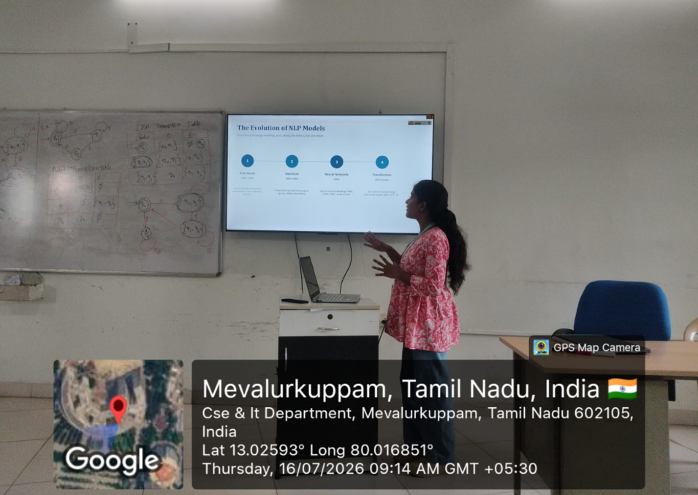
GEO TAG

Slide 7
Transformers & Attention
Self-attention lets every token weigh every other token, in parallel
Query
Key
Value
Multi-head attention runs several attention operations in parallel, letting the model capture different types of relationships at once.
Attention Weights
(softmax of Q·Kᵀ)
No recurrence means tokens are processed in parallel, making transformers far faster to train on large corpora than RNNs.
Weighted Context Vector
BERT
GPT
T5
Bidirectional encoder, pretrained via masked language modeling
Autoregressive decoder, pretrained to predict the next token
Encoder-decoder framing every task as text-to-text

Slide 8
Key Takeaways
Choosing a model is a trade-off between interpretability, data needs, and accuracy
Approach | Core Idea | Examples | Best For
Statistical | Probabilities from corpus counts | N-grams, HMM, Naive Bayes | Small data, interpretability
Sequence Labeling | Structured prediction over sequences | HMM, CRF, Viterbi | Tagging, entity recognition
Neural Networks | Learned dense representations | RNN, LSTM, GRU, CNN | Medium data, sequential context
Transformers | Parallel self-attention | BERT, GPT, T5 | Large data, state-of-the-art accuracy
Thank you — questions?

